Slide 1
Handling Missing Values in Machine Learning

Slide 2
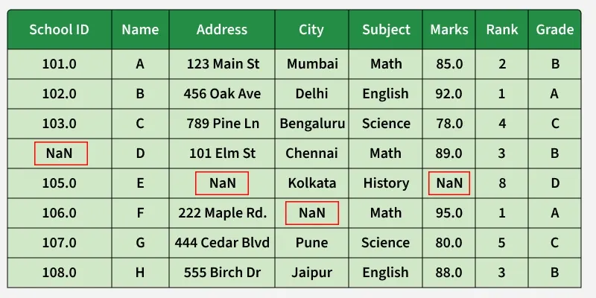
Missing data occurs when certain records in a dataset are empty, represented as NaN, None, or placeholder values such as "Unknown". If these missing entries are not addressed appropriately, they can lower model performance, introduce bias, and cause issues with algorithms that expect complete datasets.
Improves model reliability
Reduces potential bias
Preserves the amount of available data
Ensures proper functioning of machine learning algorithms

Slide 3
Missing Values
Causes of Missing Data in a Dataset
Missing data can arise for a variety of reasons, and recognizing the underlying cause is essential for choosing the most suitable treatment approach. Some common causes include:
System failures: Problems during data collection, storage, or transmission may result in missing records.
Manual mistakes: Data entry errors or omissions made by users or operators.
Confidentiality restrictions: Certain sensitive details may be intentionally withheld to protect privacy.
Processing and integration errors: Missing values introduced while cleaning, transforming, or merging datasets.
Understanding why values are absent helps determine their effect on data quality, identify possible biases, and decide whether techniques such as imputation or record deletion are appropriate.
Categories of Missing Values
MCAR (Missing Completely at Random) The occurrence of missing values is entirely random and has no relationship with any observed or unobserved variable in the dataset.
MAR (Missing at Random) The missingness is associated with other available variables in the dataset but not with the missing value itself.
MNAR (Missing Not at Random) The probability of a value being missing is directly linked to the missing value. For example, individuals with very high salaries may choose not to disclose their income.

Slide 4
Methods for Identifying Missing Data
Finding and handling missing values is a crucial step in data preprocessing and analysis. Pandas provides several built-in functions that help identify, eliminate, and fill missing values within a DataFrame. These functions make it easier to detect null entries and apply appropriate techniques for data cleaning. Following are the functions with their descriptions :

Slide 5
.isnull() | Detect missing values
.notnull() | Detect non-missing values
.info() | Summary with missing counts
.isna() | Same as isnull().
dropna() | Remove missing rows/columns
fillna() | Fill missing values
replace() | Replace specific values
drop_duplicates() | Remove duplicate rows
unique() | Get unique values in a Series/DataFrame

Slide 6
Representation of Missing Values in Datasets
Missing data may be represented in various ways across datasets. Maintaining a standardized and clearly documented format helps ensure accurate data processing and analysis.
Common forms of missing value representation include:
Empty fields: Blank entries found in spreadsheets, databases, or CSV files.
Placeholder values: Indicators such as "NA", "NaN", "NULL", or special numeric values like -999.
Status labels: Codes such as "MISSING", "UNKNOWN", or similar markers used to denote unavailable information.
Techniques for Managing Missing Values in Data Analysis
The appropriate treatment of missing data depends on the dataset, the amount of missingness, and its underlying cause. Applying suitable handling techniques helps preserve data quality and improve analytical results.
Several methods can be used to address missing values effectively, each selected according to the characteristics and requirements of the analysis.
Creating a Sample DataFrame
For this example, we will use the Pandas and NumPy libraries.

Slide 7
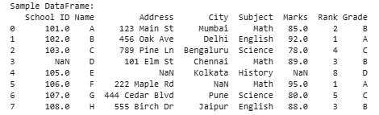
import pandas as pd
import numpy as np
data = {
'School ID': [101, 102, 103, np.nan, 105, 106, 107, 108],
'Name': ['A', 'B', 'C', 'D', 'E', 'F', 'G', 'H'],
'Address': ['123 Main St', '456 Oak Ave', '789 Pine Ln', '101 Elm St', np.nan, '222 Maple Rd', '444 Cedar Blvd', '555 Birch Dr'],
'City': ['Mumbai', 'Delhi', 'Bengaluru', 'Chennai', 'Kolkata', np.nan, 'Pune', 'Jaipur'],
'Subject': ['Math', 'English', 'Science', 'Math', 'History', 'Math', 'Science', 'English'],
'Marks': [85, 92, 78, 89, np.nan, 95, 80, 88],
'Rank': [2, 1, 4, 3, 8, 1, 5, 3],
'Grade': ['B', 'A', 'C', 'B', 'D', 'A', 'C', 'B']
}
df = pd.DataFrame(data)
print("Sample DataFrame:")
print(df)
Output ->

Slide 8
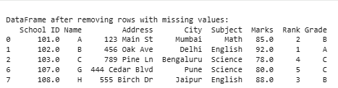
1. Deleting Rows Containing Missing Values
One of the most straightforward approaches to dealing with missing data is to remove records that contain null values. While this method simplifies the dataset, it can decrease the number of available observations and may lead to biased results if the missing data is not randomly distributed.
In this example, the dropna() function is used to eliminate rows that contain missing values from the original DataFrame (df). The resulting DataFrame (df_cleaned) is then displayed.
df_cleaned = df.dropna()
print("\nDataFrame after removing rows with missing values:")
print(df_cleaned)
Output
Advantages: Easy to apply, fast to execute, and produces a dataset without missing entries.
Disadvantages: Can reduce the amount of available data and may introduce bias into the analysis.

Slide 9
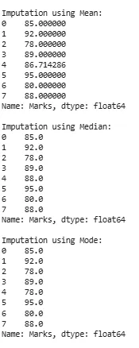
2. Imputation Techniques
Imputation is a method used to substitute missing values with estimated values, helping retain the original dataset size. However, the substituted values may not always accurately reflect the actual data.
1. Mean, Median, and Mode Imputation: This technique replaces missing entries with the mean, median, or mode of the corresponding feature. It is easy to implement but does not consider the dependencies or interactions among variables.
Output:
mean_imputation = df['Marks'].fillna(df['Marks'].mean())
median_imputation = df['Marks'].fillna(df['Marks'].median())
mode_imputation = df['Marks'].fillna(df['Marks'].mode().iloc[0])
print("\nImputation using Mean:")
print(mean_imputation)
print("\nImputation using Median:")
print(median_imputation)
print("\nImputation using Mode:")
print(mode_imputation)

Slide 10
Explanation: In this example, different imputation methods are applied to manage missing values in the 'Marks' column of the DataFrame (df). The missing entries are replaced using the mean, median, and mode calculated from the available values in the same column, and the updated results are displayed for comparison.
df['Marks'].fillna(df['Marks'].mean()): Replaces missing values in the 'Marks' column with the average of the existing values.
df['Marks'].fillna(df['Marks'].median()): Replaces missing values in the 'Marks' column with the middle value of the existing data.
df['Marks'].fillna(df['Marks'].mode()): Replaces missing values in the 'Marks' column with the most frequently occurring value.
.iloc[0]: Retrieves the first value from the mode result, which is returned as a Series.
Advantages: Simple to apply, computationally efficient, and effective for numerical data.
Disadvantages: Can alter the original data distribution and may not accurately reflect the actual missing values.
2. Forward Fill and Backward Fill
These approaches replace missing values with nearby available values within the same column. They are particularly useful for sequential, ordered, or time-series datasets where adjacent observations are related.

Slide 11
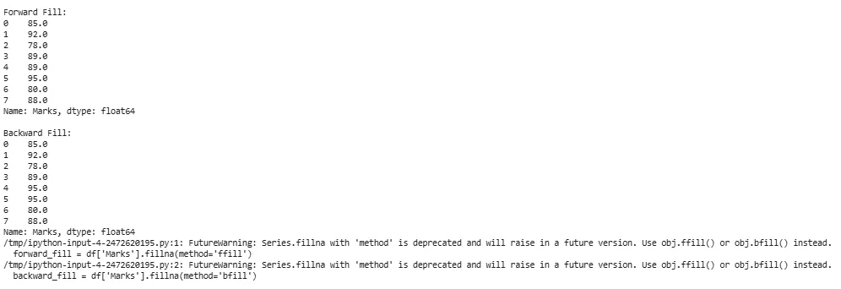
forward_fill = df['Marks'].fillna(method='ffill')
backward_fill = df['Marks'].fillna(method='bfill')
print("\nForward Fill:")
print(forward_fill)
print("\nBackward Fill:")
print(backward_fill)
Output:

Slide 12
Explanation: The method parameter in fillna() is used to define how missing values should be filled.
df['Marks'].fillna(method='ffill'): Applies the forward fill approach to the 'Marks' column. Missing values are replaced with the most recent non-missing value that appears before them.
df['Marks'].fillna(method='bfill'): Applies the backward fill approach to the 'Marks' column. Missing values are replaced with the nearest non-missing value that appears after them.
Advantages: Maintains the sequence and underlying structure of the data.
Disadvantages: May produce unreliable results when there are large gaps between observations or when neighboring values vary considerably.
Note:
Forward Fill (ffill): Replaces missing values using the previous valid observation.
Backward Fill (bfill): Replaces missing values using the next valid observation.
3. Interpolation Methods
Interpolation fills missing values by estimating them from the pattern and trend of nearby data points. Compared to basic imputation methods, it often provides more realistic and data-driven estimates.

Slide 13
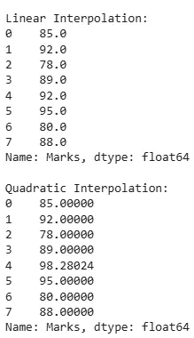
linear_interpolation = df['Marks'].interpolate(method='linear')
quadratic_interpolation = df['Marks'].interpolate(method='quadratic')
print("\nLinear Interpolation:")
print(linear_interpolation)
print("\nQuadratic Interpolation:")
print(quadratic_interpolation)
Explanation: The interpolate() function in Pandas can estimate missing values using different interpolation techniques, such as linear and quadratic interpolation.
df['Marks'].interpolate(method='linear'): Applies linear interpolation to the 'Marks' column by estimating missing values based on a straight-line relationship between neighboring data points.
df['Marks'].interpolate(method='quadratic'): Applies quadratic interpolation to the 'Marks' column by estimating missing values using a quadratic curve fitted to surrounding observations.
Advantages: Effectively follows data trends and helps maintain relationships among values.
Disadvantages: Relies on assumptions about the underlying pattern (such as linear or quadratic behavior) and can be more difficult to implement and interpret. Note:
Linear Interpolation: Estimates missing values by assuming a straight-line connection between adjacent known values.
Quadratic Interpolation: Estimates missing values by fitting a quadratic curve through nearby known observations.
Output:

Slide 14
Impact of Handling Missing Values
Proper management of missing values is essential for obtaining dependable analytical results and building effective machine learning models.
Better Data Quality: Reducing or treating missing values improves the overall quality and usability of the dataset.
Improved Model Accuracy: Handling missing data appropriately enables models to learn from more complete information, resulting in stronger predictive performance.
Maintained Data Consistency: Techniques such as imputation or removal of missing entries help preserve the consistency and correctness of the dataset for future analysis.
Minimized Bias: Addressing missing values reduces the risk of biased outcomes and supports a more accurate understanding of patterns within the data.

